Slide 1

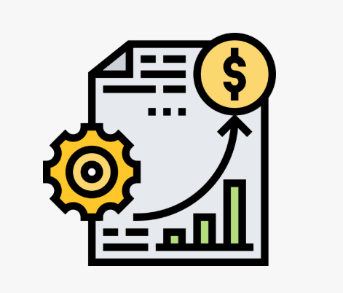
Manufacturing Performance Analytics Dashboard
CHAITRA
KRISH
SUYASH
NAGARAJ
LIKHITH
ABHISHEK
NAVEED

Slide 2
Problem Statement:
Manufacturing industries face challenges in monitoring production, rejected quantity, machine performance, and employee efficiency. The goal of this project is to design an end-to-end analytics solution to:
Track monthly production and rejected quantity.
Identify top-performing and under-performing employees and machines.
Compare manufacturing vs rejection trend.
Improve decision-making using data insights.

Slide 3
Key Performance Indicators Used:
KPI Name | Purpose
Total Production | Measures total manufactured units
Processed Quantity | Tracks how many units passed through production stages
Efficiency % | Indicates overall operational performance
Rejected Quantity | Highlights quality issues
Machine Cost | Identifies high-cost machines
Key Insights:
Top-performing machines contribute high production with low rejection.
Certain machines or departments show high rejection and require process optimization.
Efficiency trends show improvement/decline based on date and department.

Slide 4
Excel Dashboard
The Excel dashboard highlights overall production efficiency and clearly shows
variations between manufactured, processed, and rejected quantities.
From the Excel dashboard, we can easily identify which departments and machines contributed most to rejection and which performed efficiently.
The slicers and charts in the Excel dashboard helped compare monthly production trends and detect improvement areas in rejection control.
The dashboard provides actionable insights by visualizing KPI trends such as Total Manufactured Qty, Processed Qty, and the corresponding efficiency percentage.

Slide 5
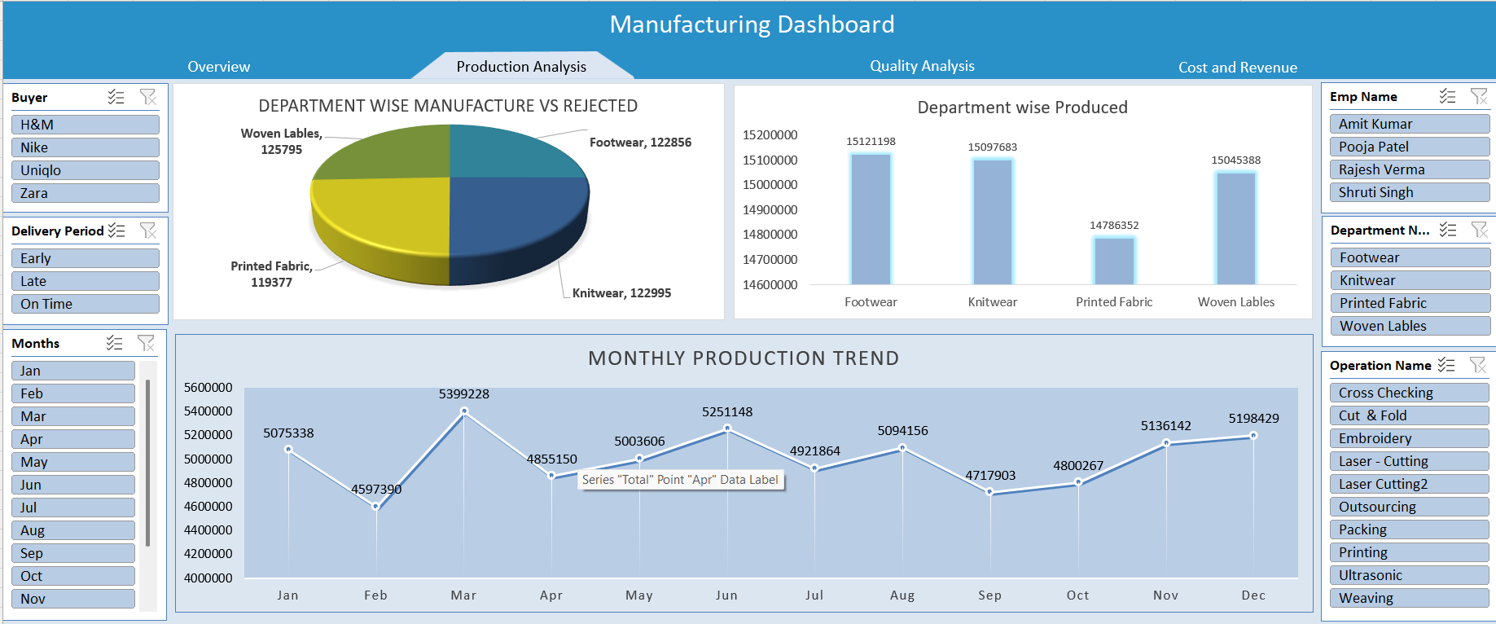
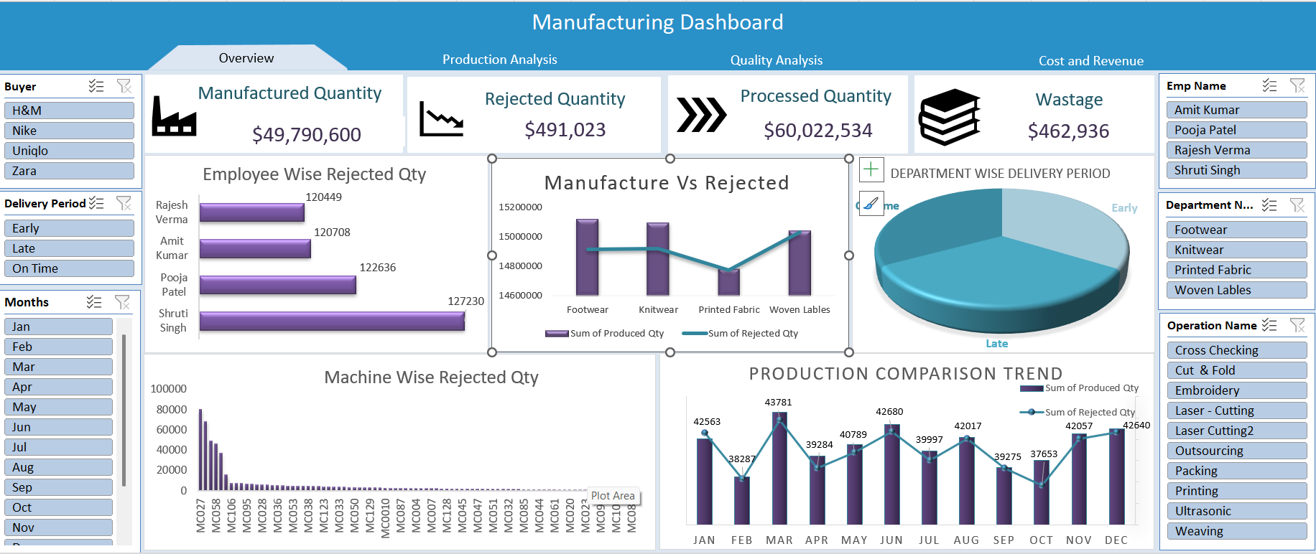
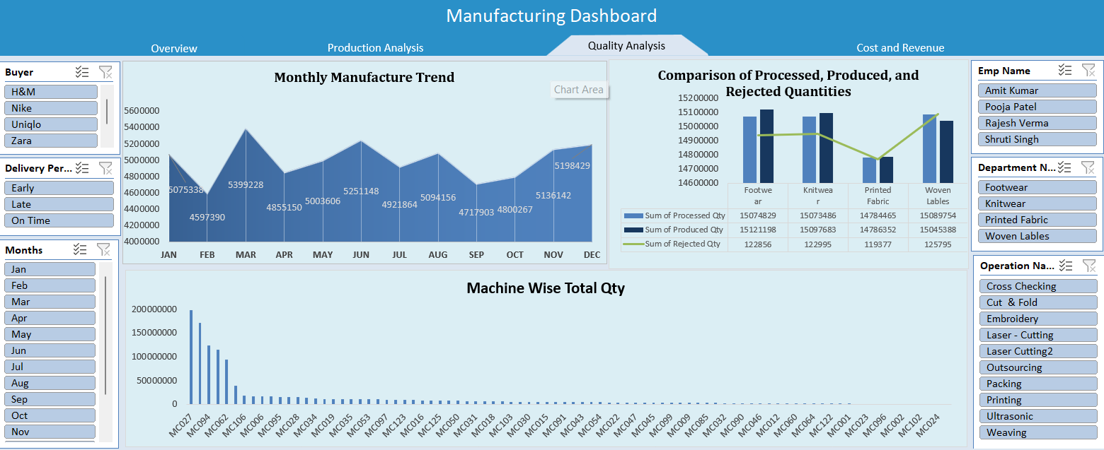
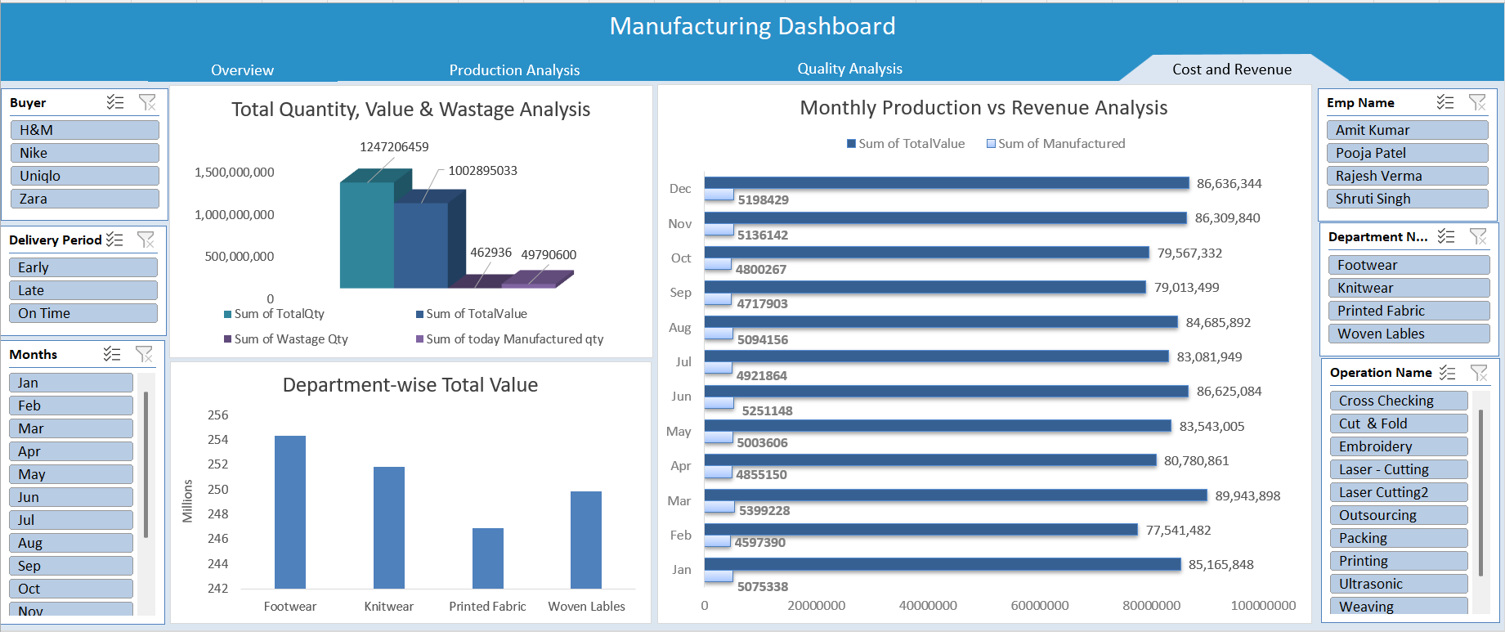

Slide 6
Tableau Dashboard
The Tableau dashboard provides deeper visibility into production trends and highlights rejection patterns using interactive visual exploration.
With Tableau, we were able to quickly identify top rejected machines and departments through drill-downs and dynamic filtering.
The visualization in Tableau allowed us to compare manufacturing performance month-wise and detect key efficiency fluctuations.
Through interactive charts, Tableau helps uncover hidden patterns in performance metrics such as Manufactured vs Rejected Quantity and Efficiency %.

Slide 7
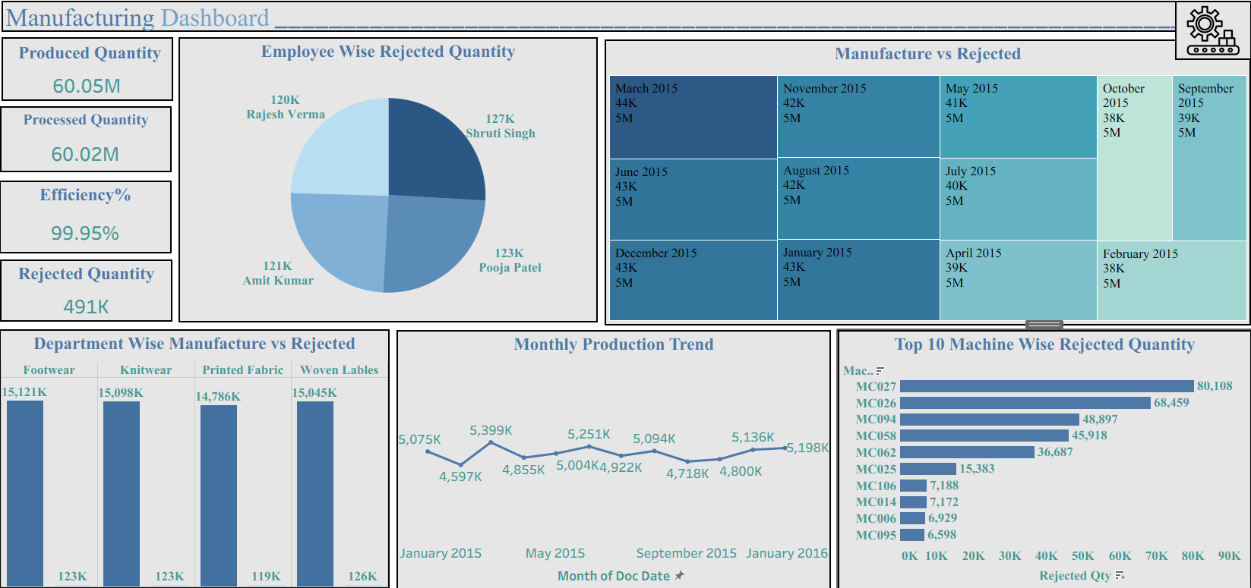

Slide 8
Power BI Dashboard
KPIs with conditional formatting
Dynamic Top-N slicer
Custom tooltip page
Drill-through analysis
Machine-wise, employee-wise and department-wise comparisons
Power BI enhanced decision-making by providing interactive dashboards and automated insights.

Slide 9
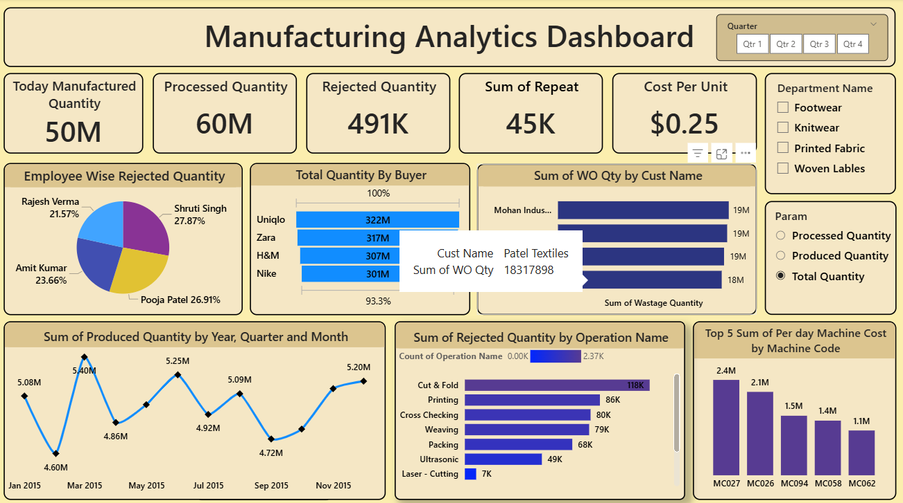

Slide 10
SQL Queries and Output
✔ SQL techniques used:
Aggregations
Joins
Stored Procedures
Views
Indexing
Parameterized functions
Window functions (Rank, Dense Rank, Row Number)
🧾 Example Output Screenshots:
Employee-wise rejection
Machine-wise rejection
Daily rejection report
Stored procedure execution

Slide 11
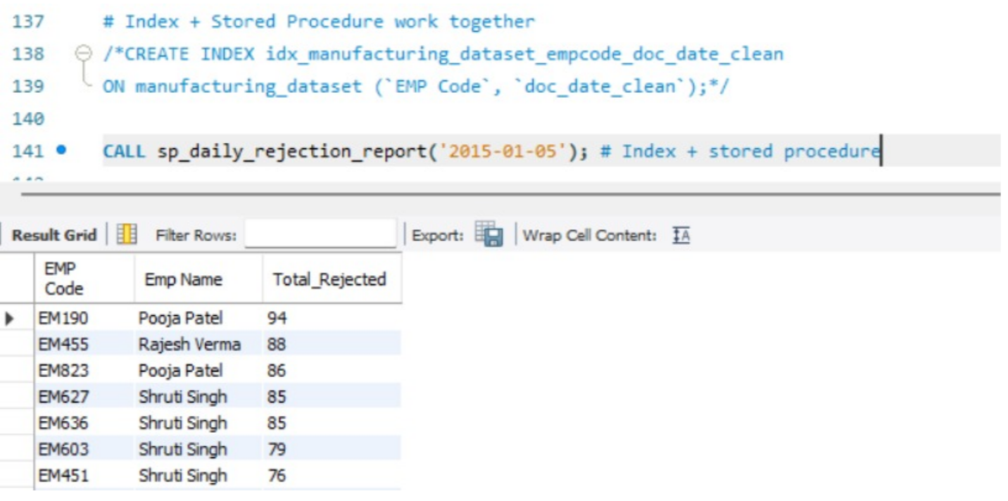
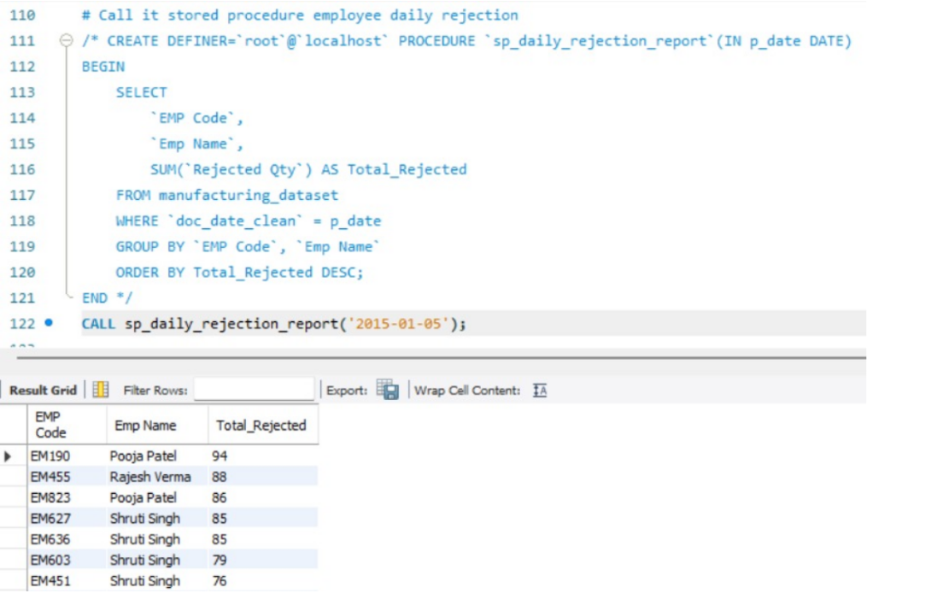
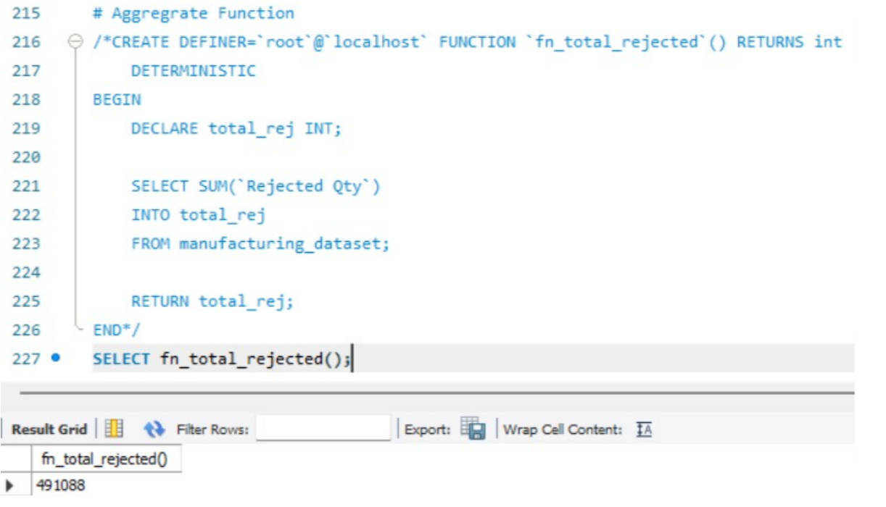
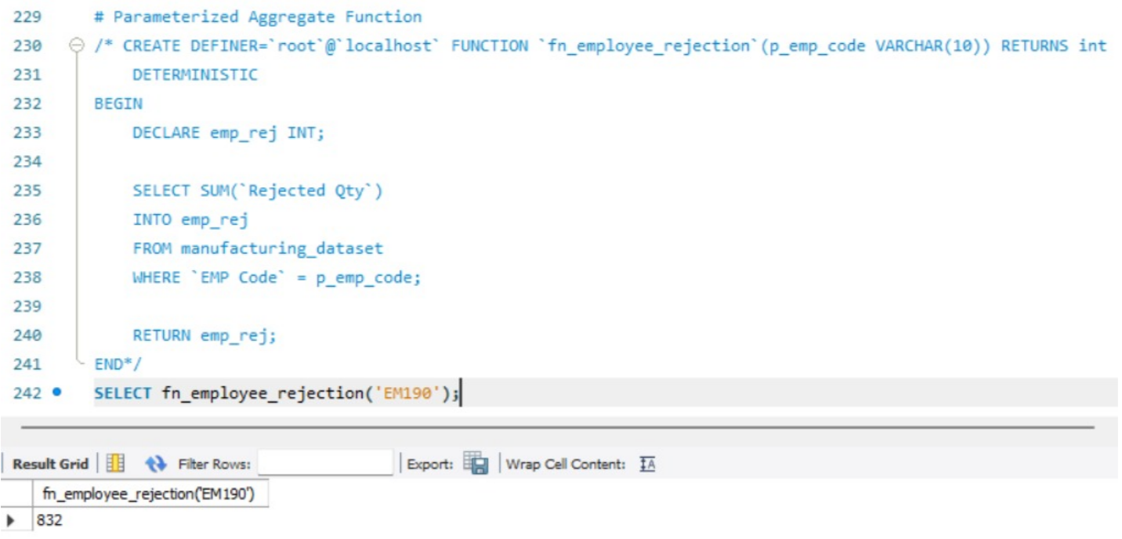

Slide 12
Project Summary
This project demonstrates the end-to-end process of transforming raw manufacturing data into meaningful insights through:
SQL for data cleaning, calculation & transformation
Excel/Tableau/Power BI for building interactive dashboards
KPIs to measure production efficiency and rejection trends
Business insights to support quality improvement and decision-making

Slide 13

Key Learnings:
Importance of data modeling
Using DAX & Parameters in Power BI
Using Tableau & Excel slicers for analysis
Writing efficient SQL queries and using views, triggers & procedures

Slide 14
Challenges Faced During the Project
Different File Formats
Data was available in multiple formats (.xlsx, .sql, .pbix, .twbx).
Integrating them into one meaningful solution required transformation and mapping.
Understanding the Business Logic
Required time to understand the meaning of production-related metrics like Manufactured Qty, Rejected Qty, Efficiency%, Machine Cost, etc.
DAX and Calculations
Creating KPIs such as Efficiency %, Top 10 Machine Rejection, and Custom Date Filters required advanced DAX formulas and testing.
Visualization Selection
Choosing the right chart type (tree map, donut, line chart, KPI cards) to ensure clarity and accuracy.
Performance Optimization
Some visuals were slow initially due to large data and unused fields.
Optimization steps like removing unnecessary columns and using star schema helped.
Alignment and Formatting
Ensuring all visuals look consistent across Excel, Tableau, and Power BI dashboards.

Slide 15
“This project gave us complete end-to-end experience in data analysis—from data cleaning to visualization and insight generation. Using Excel, SQL, Tableau, and Power BI, we analyzed manufacturing performance, identified key trends, and highlighted improvement areas. The insights will support better decisions, improve efficiency, and reduce rejection rates while strengthening our technical and analytical skills.”
---------------------------------------Thank YOU--------------------------------------

